Slide 1
Study on Latent Representation and Clustering
Kyeong Ryeol, Go
M.S. Candidate of OSI Lab

Slide 2
Explicit distribution
Disentanglement
Beta-VAE
Factor-VAE
Beta-TC-VAE
HSIC-constrained-VAE
Gaussian Mixture Model
Variational Deep Embedding (VaDE)
Gaussian Mixture VAE (GM-VAE)
Dirichlet Mixture Model
Stick Breaking VAE (SB-VAE)
Dirichlet VAE (Dir-VAE)
Flow-based
Normalizing Flows (NF)
Inverse Autoregressive Flows (IAF)
Factors of variation이 latent space의 axis로 각각 align되도록 함.
기존의 ELBO에 penalty term을 추가하거나,
기존의 ELBO를 decompose해서 특정 component의 weight를 세게 주는 방식이 있다.

Slide 3

Disentanglement
Beta-VAE
$𝔼_{q_{φ}\left(z | x\right)}\left[\log{p_{θ}\left(x | z\right)}\right]−β∙KL(q_{φ}(z|x)||p\left(z\right))$
$β=1 →original ELBO$
Factor-VAE
$𝔼_{q_{φ}\left(z | x\right)}\left[\log{p_{θ}\left(x | z\right)}\right]−β∙KL\left(q_{φ}\left(z\right)\left\|\prod_{d}{q_{φ}\left(z_{d}\right)}\right.\right)−KL(q_{φ}(z|x)||p\left(z\right))$
($q_{φ}\left(z\right)=E_{p\left(x\right)}\left[q_{φ}\left(z|x\right)\right]$)
$KL\left(q_{φ}\left(z\right)\left\|\prod_{d}{q_{φ}\left(z_{d}\right)}\right.\right)≈E_{q_{φ}\left(z\right)}\left[\log{\frac{D\left(z\right)}{1−D\left(z\right)}}\right] where D is a discriminator :q_{φ}\left(z\right) v.s. \prod_{d}{q_{φ}\left(z_{d}\right)}$
(Inner optimization loop exists)
$β=0 →original ELBO$

Slide 4
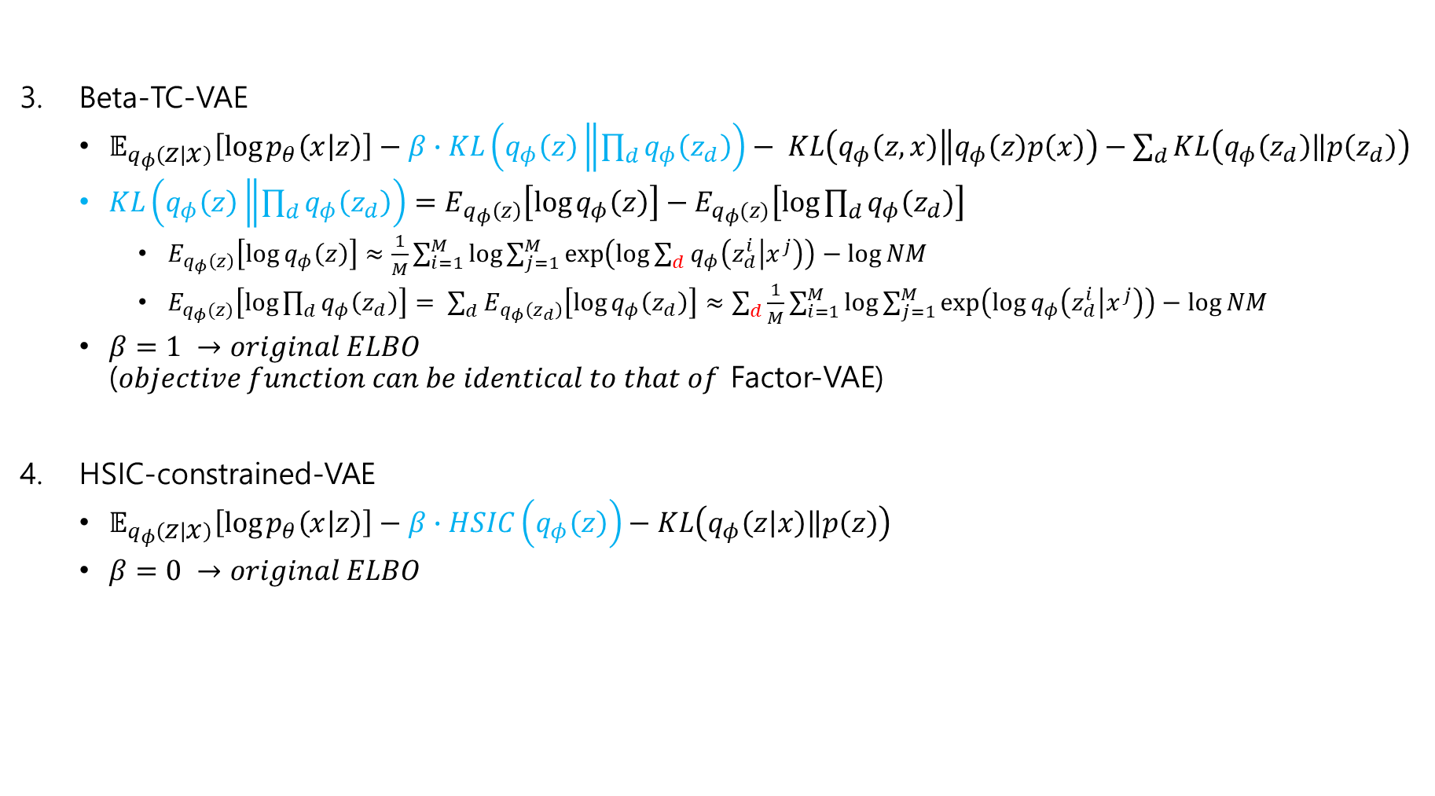
Disentanglement
Beta-TC-VAE
$𝔼_{q_{φ}\left(z | x\right)}\left[\log{p_{θ}\left(x | z\right)}\right]−β∙KL\left(q_{φ}\left(z\right)\left\|\prod_{d}{q_{φ}\left(z_{d}\right)}\right.\right)− KL\left(q_{φ}\left(z,x\right)\left\|q_{φ}\left(z\right)p\left(x\right)\right.\right)−\sum_{d}{KL\left(q_{φ}\left(z_{d}\right)\left\|p\left(z_{d}\right)\right.\right)}$
$KL\left(q_{φ}\left(z\right)\left\|\prod_{d}{q_{φ}\left(z_{d}\right)}\right.\right)=E_{q_{φ}\left(z\right)}\left[\log{q_{φ}\left(z\right)}\right]−E_{q_{φ}(z)}\left[\log{\prod_{d}{q_{φ}\left(z_{d}\right)}}\right]$
$E_{q_{φ}\left(z\right)}\left[\log{q_{φ}\left(z\right)}\right]≈\frac{1}{M}\sum_{i=1}^{M}{\log{\sum_{j=1}^{M}{\exp\left(\log{\sum_{d}{q_{φ}\left(z_{d}^{i} | x^{j}\right)}}\right)}}}−\log{NM}$
$E_{q_{φ}(z)}\left[\log{\prod_{d}{q_{φ}\left(z_{d}\right)}}\right]= \sum_{d}{E_{q_{φ}\left(z_{d}\right)}\left[\log{q_{φ}\left(z_{d}\right)}\right]}≈\sum_{d}{\frac{1}{M}\sum_{i=1}^{M}{\log{\sum_{j=1}^{M}{\exp\left(\log{q_{φ}\left(z_{d}^{i} | x^{j}\right)}\right)}}}}−\log{NM}$
$β=1 →original ELBO$ ($objective function can be identical to that of$ Factor-VAE)
HSIC-constrained-VAE
$𝔼_{q_{φ}\left(z | x\right)}\left[\log{p_{θ}\left(x | z\right)}\right]−β∙HSIC\left(q_{φ}\left(z\right)\right)−KL\left(q_{φ}\left(z | x\right)\left\|p\left(z\right)\right.\right)$
$β=0 →original ELBO$

Slide 5
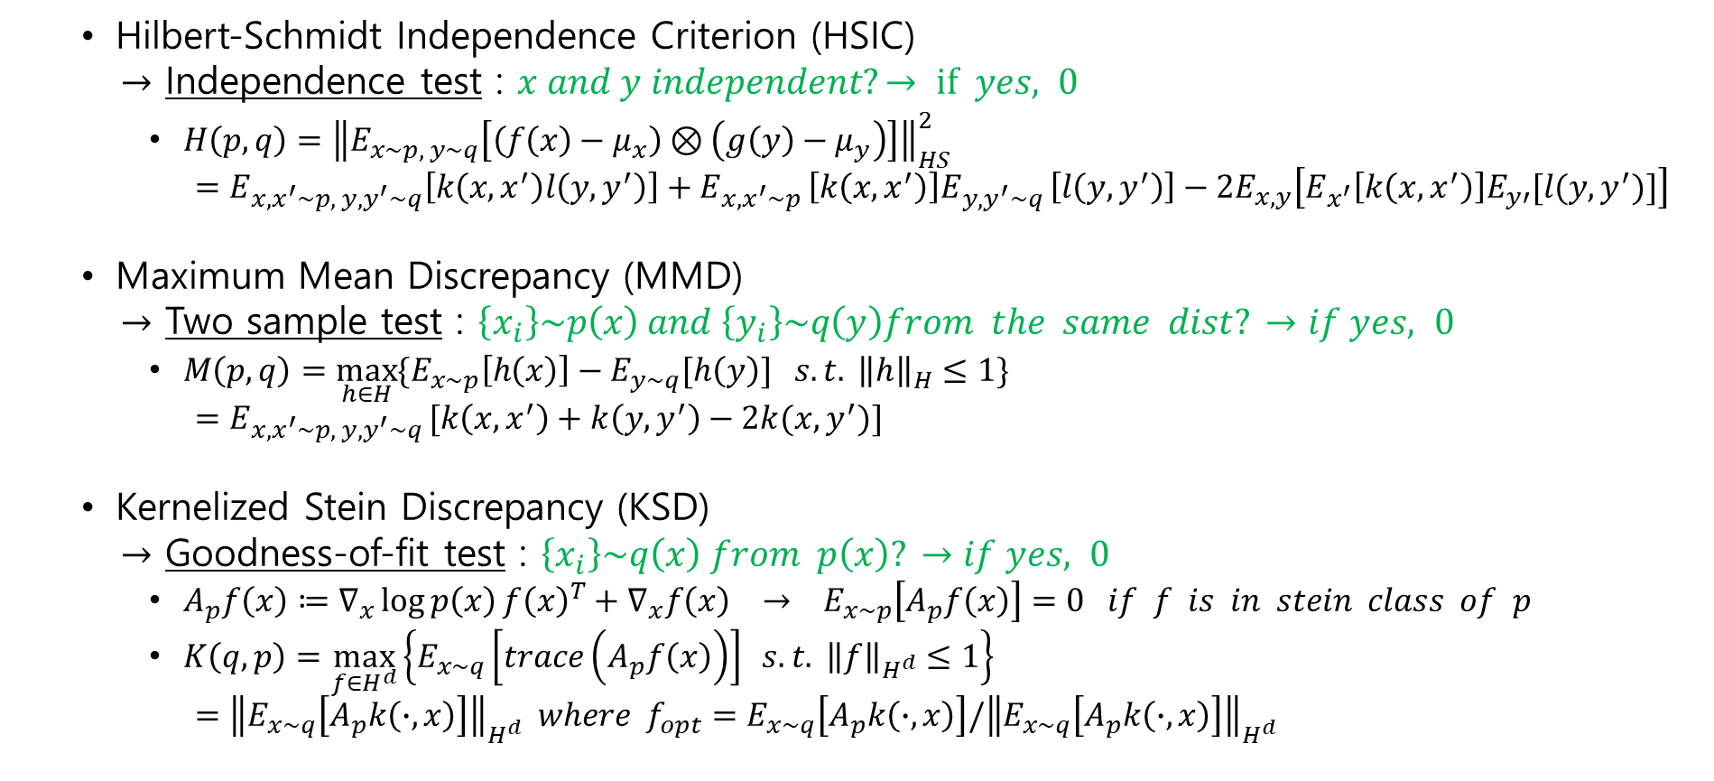
Measure between prob. dist. by kernel
Hilbert-Schmidt Independence Criterion (HSIC)
$→$ Independence test : $x and y independent?→ if yes, 0$
$H\left(p,q\right)={\left\|E_{x\sim p, y\sim q}\left[\left(f\left(x\right)−μ_{x}\right)⊗\left(g\left(y\right)−μ_{y}\right)\right]\right\|}_{HS}^{2}$ $=E_{x,x^{′}\sim p, y,y^{′}\sim q}\left[k\left(x,x^{′}\right)l\left(y,y^{′}\right)\right]+E_{x,x^{′}\sim p }\left[k\left(x,x^{′}\right)\right]E_{y,y^{′}\sim q }\left[l\left(y,y^{′}\right)\right]−2E_{x,y}\left[E_{x^{′}}\left[k\left(x,x^{′}\right)\right]E_{y′}[l(y,y^{′})]\right]$
Maximum Mean Discrepancy (MMD)
$→$ Two sample test : $\left\{x_{i}\right\}\sim p\left(x\right) and \left\{y_{i}\right\}\sim q\left(y\right)from the same dist? →if yes, 0$
$M\left(p,q\right)=\max_{h∈H}{\{E_{x\sim p}\left[h\left(x\right)\right]−E_{y\sim q}[h\left(y\right)] s.t. {\left\|h\right\|}_{H}≤1\}}$ $=E_{x,x^{′}\sim p, y,y^{′}\sim q }[k\left(x,x^{′}\right)+k\left(y,y^{′}\right)−2k(x,y^{′})]$
Kernelized Stein Discrepancy (KSD)
$→$ Goodness-of-fit test : $\left\{x_{i}\right\}\sim q\left(x\right) from p\left(x\right)? →if yes, 0$
$A_{p}f\left(x\right)≔∇_{x}\log{p\left(x\right)}f{\left(x\right)}^{T}+∇_{x}f\left(x\right) → E_{x\sim p}\left[A_{p}f\left(x\right)\right]=0 if f is in stein class of p$
$K\left(q,p\right)=\max_{f∈H^{d}}\left\{E_{x\sim q}\left[trace\left(A_{p}f\left(x\right)\right)\right] s.t. {\left\|f\right\|}_{H^{d}}≤1\right\}$ $={\left\|E_{x\sim q}\left[A_{p}k\left(∙,x\right)\right]\right\|}_{H^{d}} where f_{opt}=E_{x\sim q}\left[A_{p}k\left(∙,x\right)\right]/{\left\|E_{x\sim q}\left[A_{p}k\left(∙,x\right)\right]\right\|}_{H^{d}}$

Slide 6
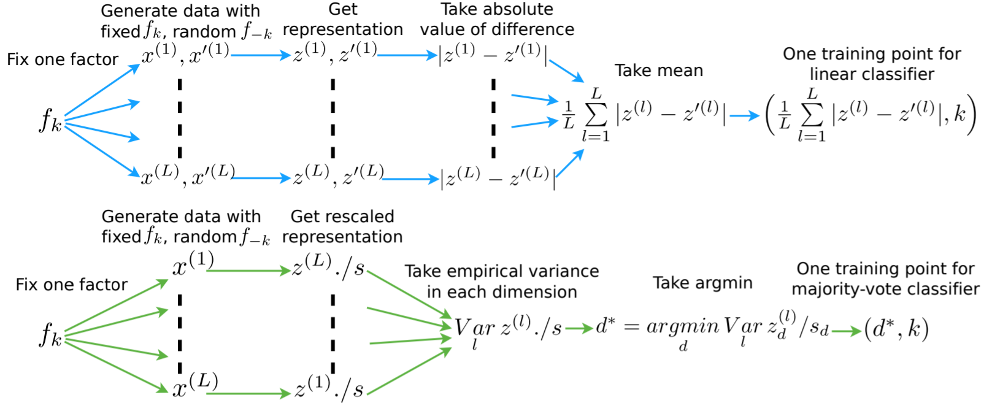
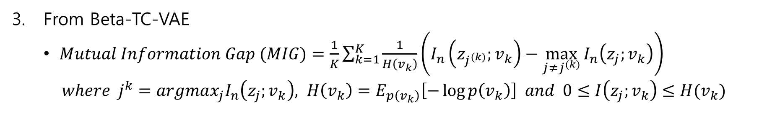
Disentanglement measure
From Beta-VAE
From Factor-VAE
From Beta-TC-VAE
$Mutual Information Gap (MIG)=\frac{1}{K}\sum_{k=1}^{K}{\frac{1}{H\left(v_{k}\right)}\left(I_{n}\left(z_{j^{(k)}};v_{k}\right)−\max_{j≠j^{(k)}}{I_{n}\left(z_{j};v_{k}\right)}\right)}$
$where j^{k}=argmax_{j}I_{n}\left(z_{j};v_{k}\right), H\left(v_{k}\right)=E_{p\left(v_{k}\right)}\left[−\log{p\left(v_{k}\right)}\right] and 0≤I\left(z_{j};v_{k}\right)≤H(v_{k})$

Slide 7
Explicit distribution
Disentanglement
Beta-VAE
Factor-VAE
Beta-TC-VAE
HSIC-constrained-VAE
Gaussian Mixture Model
Variational Deep Embedding (VaDE)
Gaussian Mixture VAE (GM-VAE)
Dirichlet Mixture Model
Stick Breaking VAE (SB-VAE)
Dirichlet VAE (Dir-VAE)
Flow-based
Normalizing Flows (NF)
Inverse Autoregressive Flows (IAF)

Slide 8
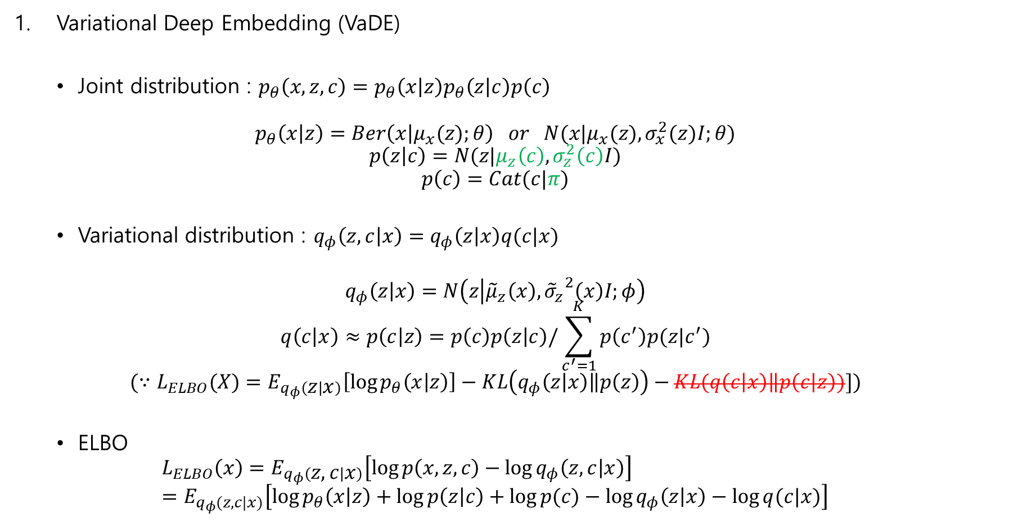
Gaussian Mixture Model
Variational Deep Embedding (VaDE)
Joint distribution : $p_{θ}\left(x,z,c\right)=p_{θ}\left(x | z\right)p_{θ}\left(z | c\right)p\left(c\right)$
$$p_{θ}\left(x | z\right)=Ber\left(x | μ_{x}(z);θ\right) or N(x|μ_{x}(z),σ_{x}^{2}(z)I;θ)$$
$$p\left(z | c\right)=N(z|μ_{z}\left(c\right), σ_{z}^{2}\left(c\right)I)$$
$$p\left(c\right)=Cat(c|π)$$
Variational distribution : $q_{φ}\left(z,c | x\right)=q_{φ}\left(z | x\right)q(c|x)$
$$q_{φ}\left(z | x\right)=N\left(z | {\tilde{μ}}_{z}\left(x\right), {{\tilde{σ}}_{z}}^{2}\left(x\right)I;φ\right)$$
$$q\left(c | x\right)≈p\left(c | z\right)=p\left(c\right)p\left(z | c\right)/\sum_{c^{′}=1}^{K}{p\left(c^{′}\right)p(z|c^{′})}$$
$$(∵L_{ELBO}(X)=E_{q_{φ}\left(z | x\right)}\left[\log{p_{θ}\left(x | z\right)}\right]−KL\left(q_{φ}\left(z | x\right)\left\|p\left(z\right)\right.\right)−KL(q\left(c | x\right)\left\|p\left(c | z\right)\right.)])$$
ELBO
$$L_{ELBO}\left(x\right)=E_{q_{φ}\left(z,c | x\right)}\left[\log{p\left(x,z,c\right)}−\log{q_{φ}\left(z,c | x\right)}\right] \\ =E_{q_{φ}(z,c|x)}\left[\log{p_{θ}\left(x | z\right)}+\log{p\left(z | c\right)}+\log{p(c)}−\log{q_{φ}\left(z | x\right)}−\log{q(c|x)}\right]$$

Slide 9
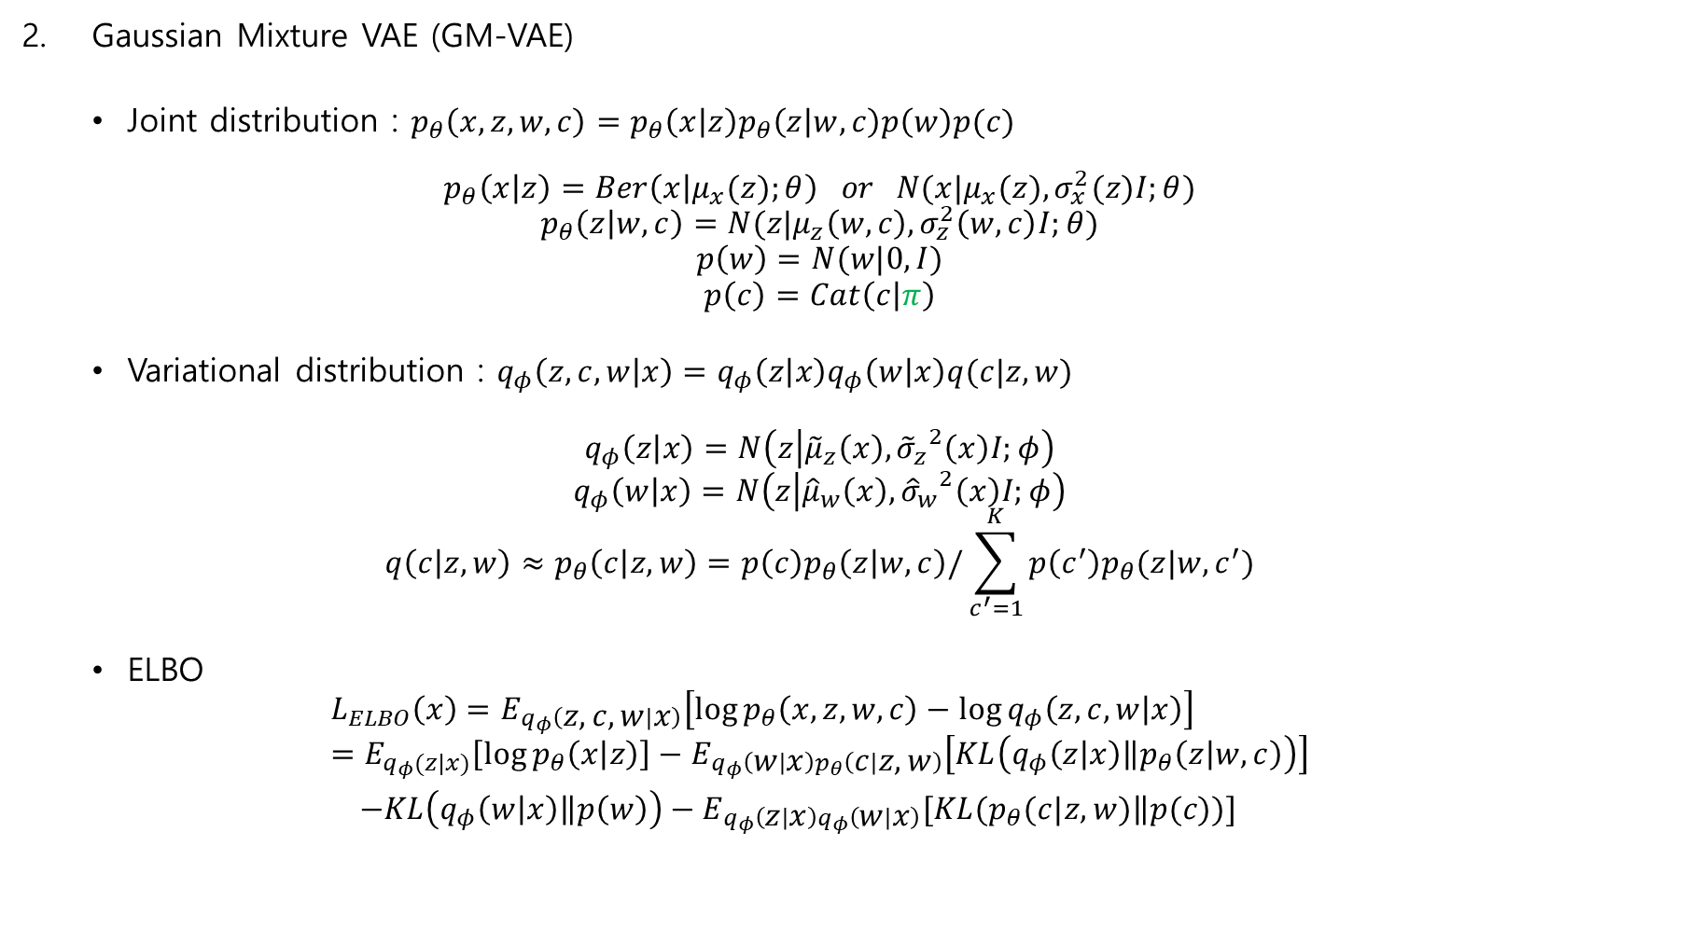
Gaussian Mixture Model
Gaussian Mixture VAE (GM-VAE)
Joint distribution : $p_{θ}\left(x,z,w,c\right)=p_{θ}\left(x | z\right)p_{θ}\left(z | w,c\right)p\left(w\right)p(c)$
$$p_{θ}\left(x | z\right)=Ber\left(x | μ_{x}(z);θ\right) or N(x|μ_{x}(z),σ_{x}^{2}(z)I;θ)$$
$$p_{θ}\left(z | w,c\right)=N(z|μ_{z}\left(w,c\right), σ_{z}^{2}\left(w,c\right)I;θ)$$
$$p\left(w\right)=N(w|0,I)$$
$$p\left(c\right)=Cat\left(c | π\right)$$
Variational distribution : $q_{φ}\left(z,c,w | x\right)=q_{φ}\left(z | x\right)q_{φ}\left(w | x\right)q(c|z,w)$
$$q_{φ}\left(z | x\right)=N\left(z | {\tilde{μ}}_{z}\left(x\right), {{\tilde{σ}}_{z}}^{2}\left(x\right)I;φ\right)$$
$$q_{φ}\left(w | x\right)=N\left(z | {\hat{μ}}_{w}\left(x\right), {{\hat{σ}}_{w}}^{2}\left(x\right)I;φ\right)$$
$$q\left(c | z,w\right)≈p_{θ}\left(c | z,w\right)=p\left(c\right)p_{θ}\left(z | w,c\right)/\sum_{c^{′}=1}^{K}{p\left(c^{′}\right)p_{θ}(z|w,c^{′})}$$
ELBO
$$L_{ELBO}\left(x\right)=E_{q_{φ}\left(z,c,w | x\right)}\left[\log{p_{θ}\left(x,z,w,c\right)}−\log{q_{φ}\left(z,c,w | x\right)}\right] \\ =E_{q_{φ}(z|x)}\left[\log{p_{θ}\left(x | z\right)}\right]−E_{q_{φ}\left(w | x\right)p_{θ}\left(c | z,w\right)}\left[KL\left(q_{φ}\left(z | x\right)\left\|p_{θ}\left(z | w,c\right)\right.\right)\right]$$ $−KL\left(q_{φ}\left(w | x\right)\left\|p\left(w\right)\right.\right)−E_{q_{φ}\left(z | x\right)q_{φ}\left(w | x\right)}[KL(p_{θ}(c|z,w)\left\|p(c)\right.)]$

Slide 10
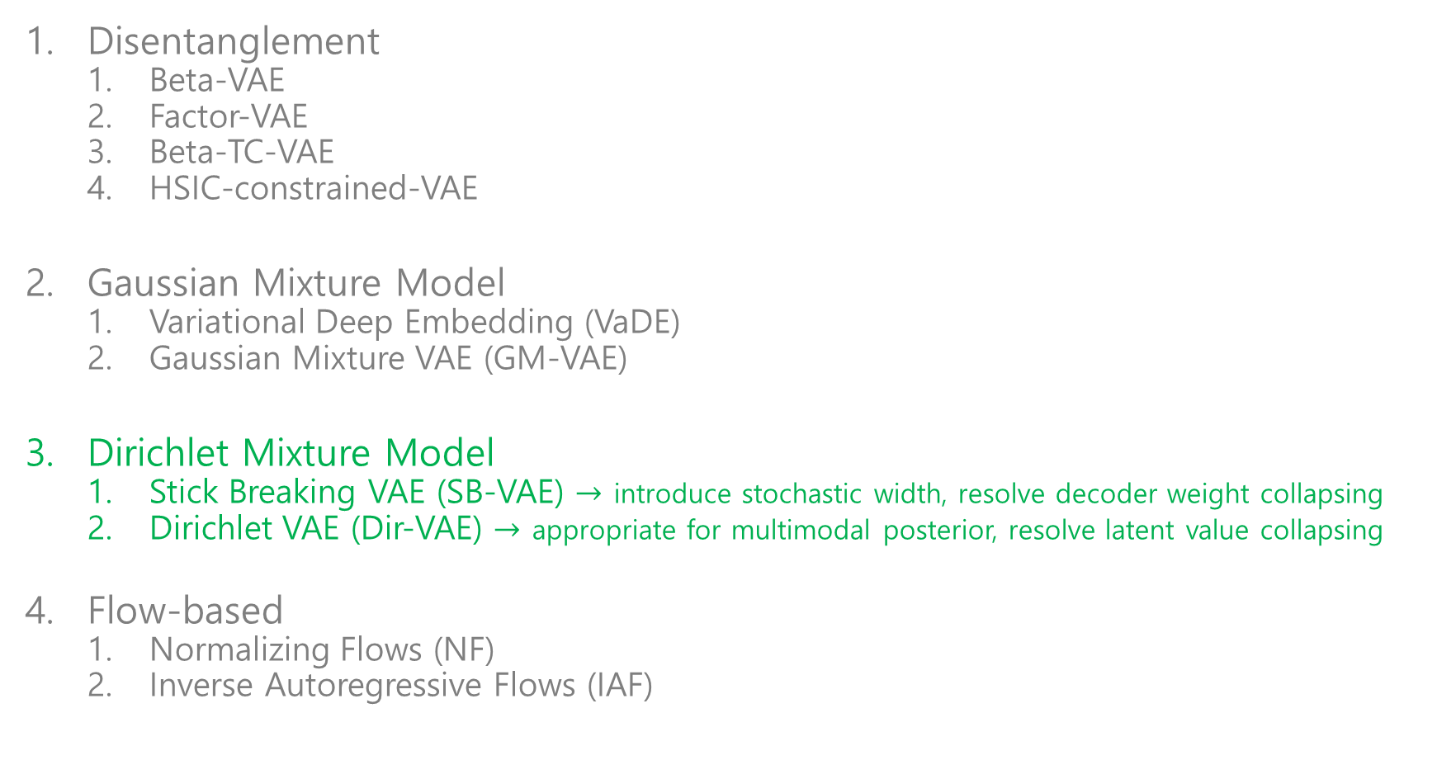
Explicit distribution
Disentanglement
Beta-VAE
Factor-VAE
Beta-TC-VAE
HSIC-constrained-VAE
Gaussian Mixture Model
Variational Deep Embedding (VaDE)
Gaussian Mixture VAE (GM-VAE)
Dirichlet Mixture Model
Stick Breaking VAE (SB-VAE) $→$ introduce stochastic width, resolve decoder weight collapsing
Dirichlet VAE (Dir-VAE) $→$ appropriate for multimodal posterior, resolve latent value collapsing
Flow-based
Normalizing Flows (NF)
Inverse Autoregressive Flows (IAF)

Slide 11
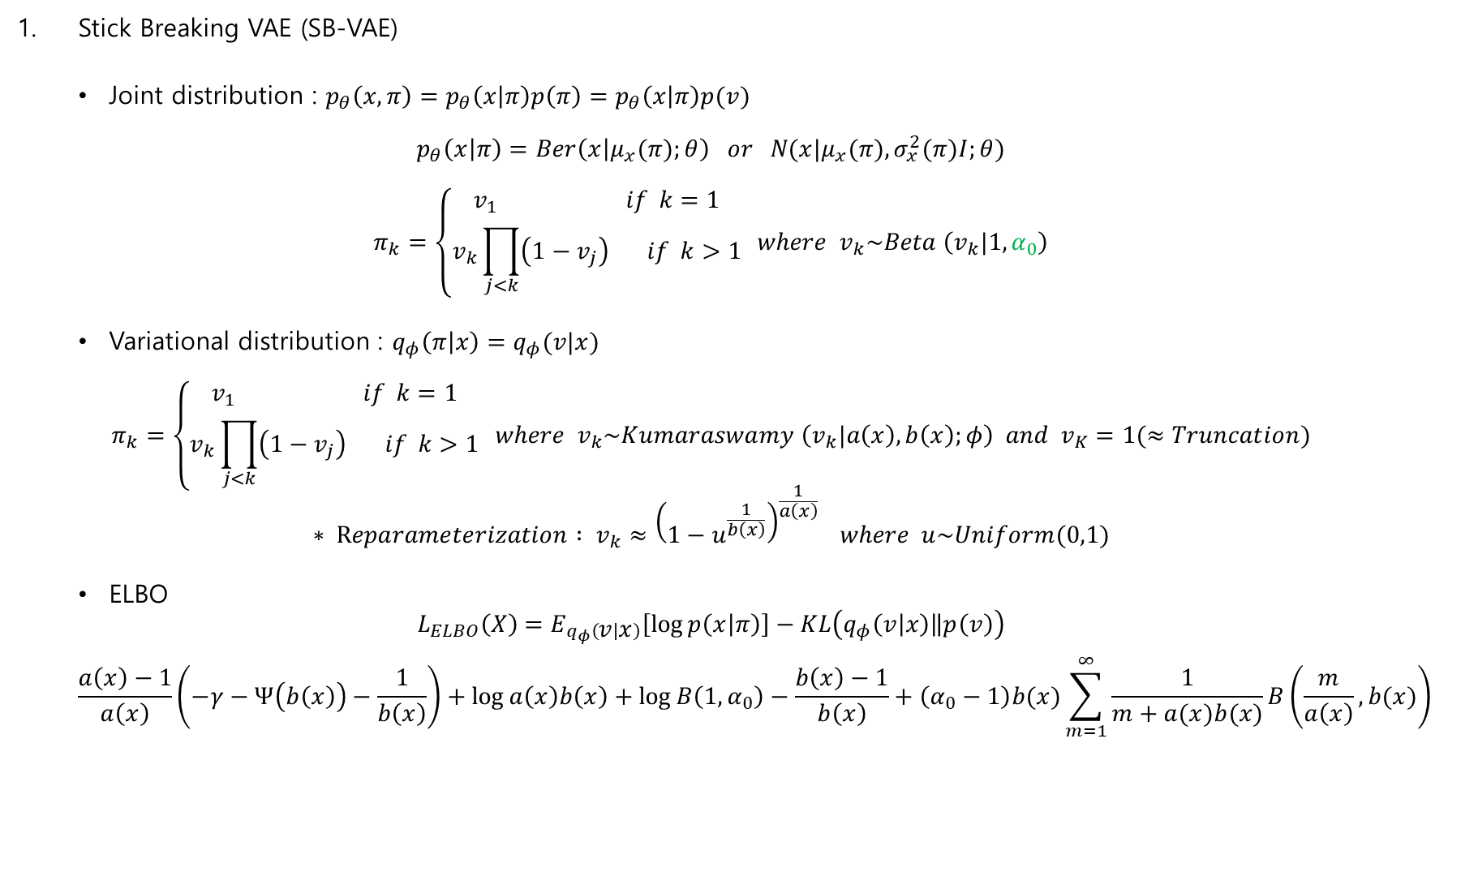
Dirichlet Mixture Model
Stick Breaking VAE (SB-VAE)
Joint distribution : $p_{θ}\left(x,π\right)=p_{θ}\left(x | π\right)p\left(π\right)=p_{θ}\left(x | π\right)p(v)$
$$p_{θ}\left(x | π\right)=Ber\left(x | μ_{x}(π);θ\right) or N(x|μ_{x}(π),σ_{x}^{2}(π)I;θ)$$
$$π_{k}=\left\{\begin{aligned}v_{1} if k=1 \\ v_{k}\prod_{j<k}{\left(1−v_{j}\right)} if k>1\end{aligned}\right. where v_{k}\sim Beta \left(v_{k}|1,α_{0}\right)$$
Variational distribution : $q_{φ}\left(π | x\right)=q_{φ}(v|x)$
$$π_{k}=\left\{\begin{aligned}v_{1} if k=1 \\ v_{k}\prod_{j<k}{\left(1−v_{j}\right)} if k>1\end{aligned}\right. where v_{k}\sim Kumaraswamy \left(v_{k}|a\left(x\right),b\left(x\right);φ\right) and v_{K}=1(≈Truncation)$$
$$∗ Reparameterization : v_{k}≈{\left(1−u^{\frac{1}{b\left(x\right)}}\right)}^{\frac{1}{a\left(x\right)}} where u\sim Uniform(0,1)$$
ELBO
$$L_{ELBO}\left(X\right)=E_{q_{φ}\left(v | x\right)}\left[\log{p\left(x | π\right)}\right]−KL\left(q_{φ}\left(v | x\right)\left\|p\left(v\right)\right.\right)$$
$$\frac{a\left(x\right)−1}{a\left(x\right)}\left(−γ−Ψ\left(b\left(x\right)\right)−\frac{1}{b\left(x\right)}\right)+\log{a\left(x\right)b\left(x\right)}+\log{B\left(1,α_{0}\right)}−\frac{b\left(x\right)−1}{b\left(x\right)}+\left(α_{0}−1\right)b(x)\sum_{m=1}^{∞}{\frac{1}{m+a(x)b(x)}B\left(\frac{m}{a\left(x\right)},b(x)\right)}$$

Slide 12
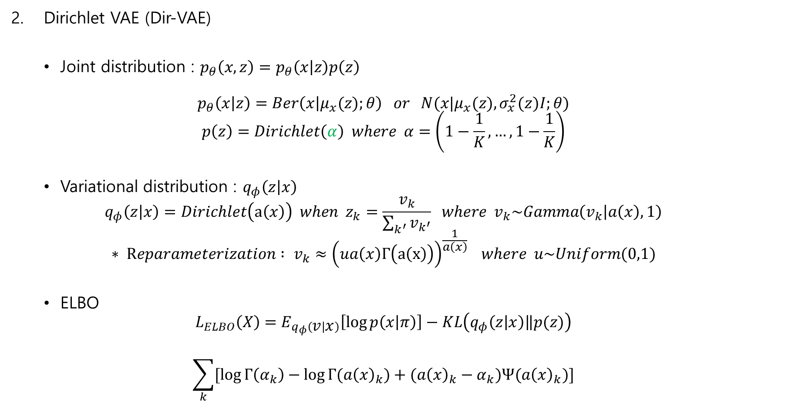
Dirichlet Mixture Model
Dirichlet VAE (Dir-VAE)
Joint distribution : $p_{θ}\left(x,z\right)=p_{θ}\left(x | z\right)p\left(z\right)$
$$p_{θ}\left(x | z\right)=Ber\left(x | μ_{x}(z);θ\right) or N(x|μ_{x}(z),σ_{x}^{2}(z)I;θ)$$
$$p\left(z\right)=Dirichlet\left(α\right) where α=\left(1−\frac{1}{K},…,1−\frac{1}{K}\right)$$
Variational distribution : $q_{φ}\left(z | x\right)$
$$q_{φ}\left(z | x\right)=Dirichlet\left(a\left(x\right)\right) when z_{k}=\frac{v_{k}}{\sum_{k^{′}}{v_{k^{′}}}} where v_{k}\sim Gamma\left(v_{k} | a\left(x\right),1\right)$$
$$∗ Reparameterization : v_{k}≈{\left(ua\left(x\right)Γ\left(a\left(x\right)\right)\right)}^{\frac{1}{a\left(x\right)}} where u\sim Uniform(0,1)$$
ELBO
$$L_{ELBO}\left(X\right)=E_{q_{φ}\left(v | x\right)}\left[\log{p\left(x | π\right)}\right]−KL\left(q_{φ}\left(z | x\right)\left\|p(z)\right.\right)$$
$$\sum_{k}{[\log{Γ\left(α_{k}\right)}−\log{Γ(a{\left(x\right)}_{k}})+(a{\left(x\right)}_{k}−α_{k})Ψ(a{\left(x\right)}_{k})]}$$

Slide 13
Explicit distribution
Disentanglement
Beta-VAE
Factor-VAE
Beta-TC-VAE
HSIC-constrained-VAE
Gaussian Mixture Model
Variational Deep Embedding (VaDE)
Gaussian Mixture VAE (GM-VAE)
Dirichlet Mixture Model
Stick Breaking VAE (SB-VAE)
Dirichlet VAE (Dir-VAE)
Flow-based
Normalizing Flows (NF)
Inverse Autoregressive Flows (IAF)
VAE-based
Restrictive하게 posterior의 form을 미리 정하지 않고, 간단한 distribution을 여러 차례 transform하는 방식을 택함으로써 ELBO를 tight하게 만듦.

Slide 14
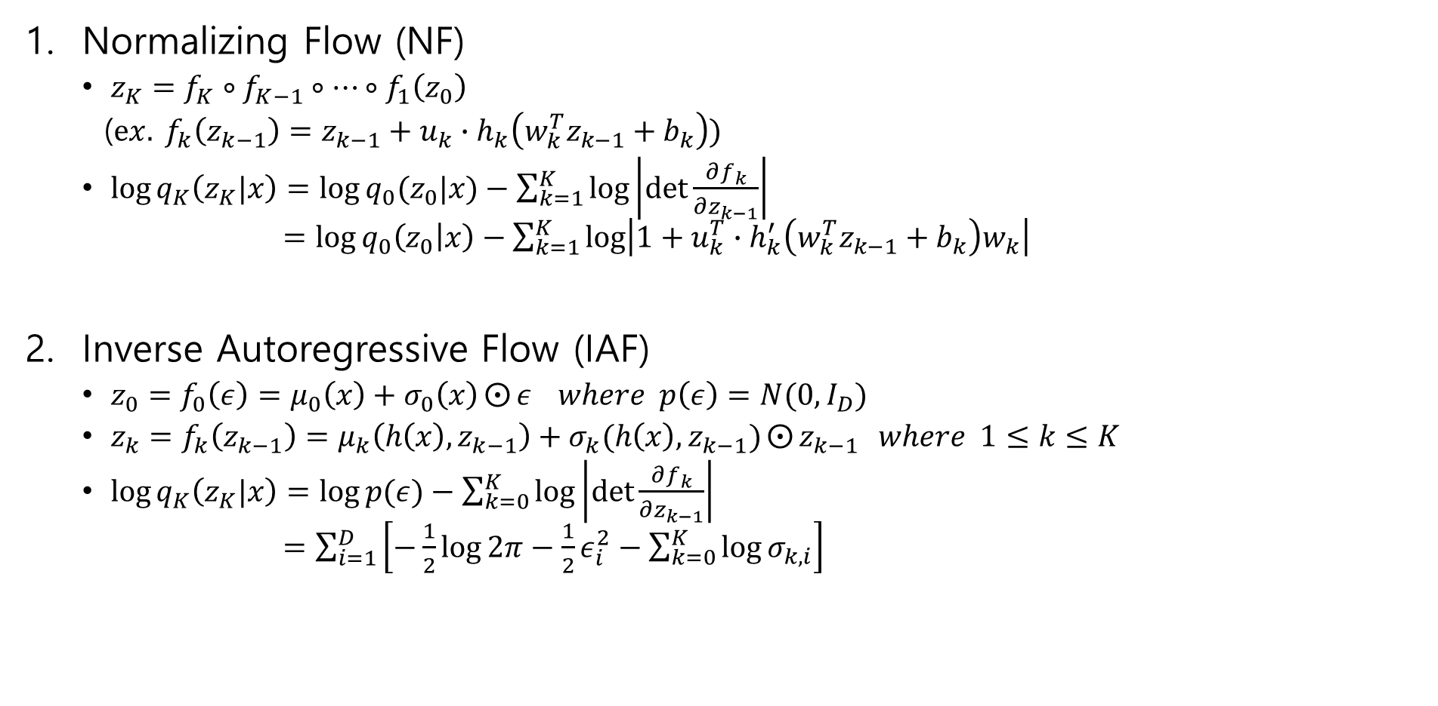
Flow-based
Normalizing Flow (NF)
$z_{K}=f_{K}∘f_{K−1}∘…∘f_{1}\left(z_{0}\right)$
($ex. f_{k}\left(z_{k−1}\right)=z_{k−1}+u_{k}∙h_{k}\left(w_{k}^{T}z_{k−1}+b_{k}\right)$)
$\log{q_{K}\left(z_{K}|x\right)}=\log{q_{0}(z_{0}|x)}−\sum_{k=1}^{K}{\log\left|\det{\frac{∂f_{k}}{∂z_{k−1}}}\right|}$ $=\log{q_{0}\left(z_{0} | x\right)}−\sum_{k=1}^{K}{\log\left|1+u_{k}^{T}∙h_{k}^{′}\left(w_{k}^{T}z_{k−1}+b_{k}\right)w_{k}\right|}$
Inverse Autoregressive Flow (IAF)
$z_{0}=f_{0}\left(ε\right)=μ_{0}\left(x\right)+σ_{0}\left(x\right)⨀{ε} where p\left(ε\right)=N(0,I_{D})$
$z_{k}=f_{k}\left(z_{k−1}\right)=μ_{k}\left(h\left(x\right), z_{k−1}\right)+σ_{k}(h\left(x\right),z_{k−1})⨀{z_{k−1}} where 1≤k≤K$
$\log{q_{K}\left(z_{K}|x\right)}=\log{p(ε)}−\sum_{k=0}^{K}{\log\left|\det{\frac{∂f_{k}}{∂z_{k−1}}}\right|}$ $=\sum_{i=1}^{D}{\left[−\frac{1}{2}\log{2π}−\frac{1}{2}ε_{i}^{2}−\sum_{k=0}^{K}{\log{σ_{k,i}}}\right]}$

Slide 15
Implicit distribution
GAN-based
Adversarial Autoencoder (AAE)
Info-GANs
Kernel-based
Stein Variational Gradient Descent (SVGD)

Slide 16
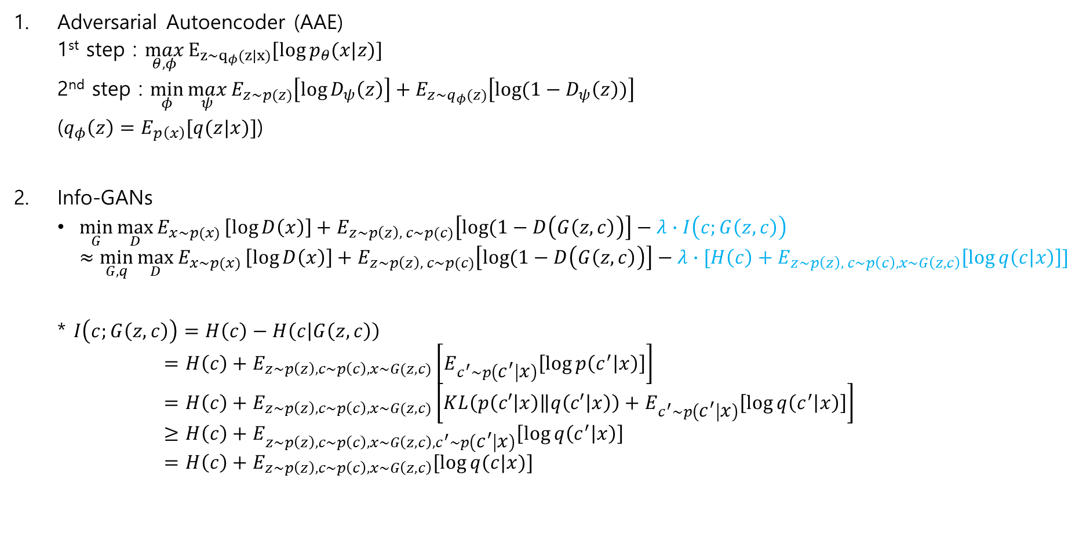
GAN-based
Adversarial Autoencoder (AAE)
1st step : $\max_{θ,φ}{E_{z\sim q_{φ}(z|x)}[log{p_{θ}(x|z)}]}$
2nd step : $\min_{φ}{\max_{ψ}{E_{z\sim p(z)}\left[\log{D_{ψ}\left(z\right)}\right]+E_{z\sim q_{φ}(z)}\left[\log{(1−D_{ψ}\left(z\right))}\right]}}$
($q_{φ}\left(z\right)=E_{p\left(x\right)}[q(z|x)]$)
Info-GANs
$\min_{G}{\max_{D}{E_{x\sim p(x)}}\left[\log{D\left(x\right)}\right]+E_{z\sim p\left(z\right), c\sim p(c)}\left[\log{(1−D\left(G\left(z,c\right)\right)}\right]−λ∙I\left(c;G\left(z,c\right)\right)}$ $≈\min_{G,q}{\max_{D}{E_{x\sim p(x)}}\left[\log{D\left(x\right)}\right]+E_{z\sim p\left(z\right), c\sim p(c)}\left[\log{(1−D\left(G\left(z,c\right)\right)}\right]−λ∙[H\left(c\right)+E_{z\sim p\left(z\right), c\sim p\left(c\right), x\sim G\left(z,c\right)}\left[\log{q\left(c | x\right)}\right]]}$
* $I\left(c;G\left(z,c\right)\right)=H\left(c\right)−H\left(c | G\left(z,c\right)\right)$ $$=H\left(c\right)+E_{z\sim p\left(z\right), c\sim p\left(c\right), x\sim G(z,c)}\left[E_{c^{′}\sim p\left(c^{′} | x\right)}\left[\log{p\left(c^{′} | x\right)}\right]\right] \\ =H\left(c\right)+E_{z\sim p\left(z\right), c\sim p\left(c\right), x\sim G(z,c)}\left[KL\left(p\left(c′ | x\right)\left\|q\left(c′ | x\right)\right.\right)+E_{c^{′}\sim p\left(c^{′} | x\right)}\left[\log{q\left(c^{′} | x\right)}\right]\right] \\ ≥H\left(c\right)+E_{z\sim p\left(z\right), c\sim p\left(c\right), x\sim G\left(z,c\right),c^{′}\sim p\left(c^{′} | x\right)}\left[\log{q\left(c^{′} | x\right)}\right] \\ =H\left(c\right)+E_{z\sim p\left(z\right), c\sim p\left(c\right), x\sim G\left(z,c\right)}[\log{q(c|x)}]$$

Slide 17
Implicit distribution
GAN-based
Adversarial Autoencoder (AAE)
Info-GANs
Kernel-based
Stein Variational Gradient Descent (SVGD)

Slide 18
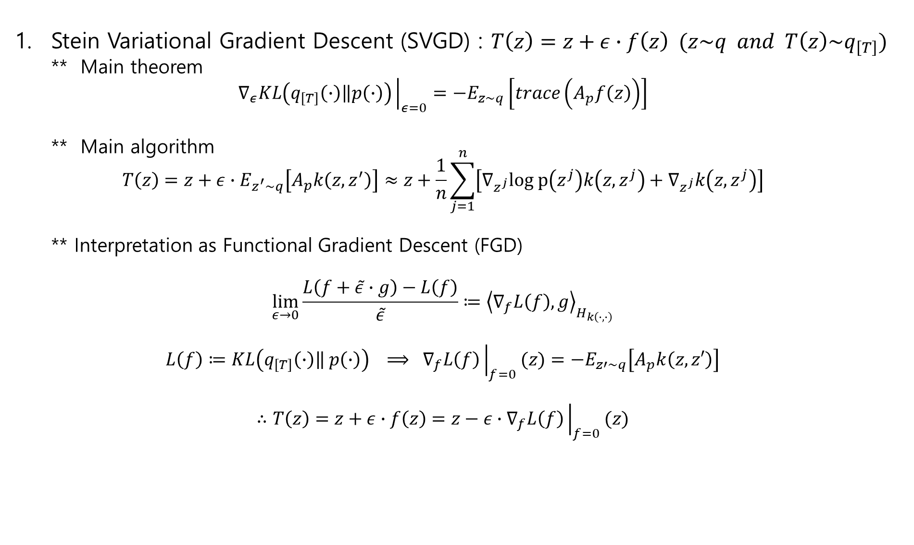
Kernel-based
Stein Variational Gradient Descent (SVGD) : $T\left(z\right)=z+ε∙f\left(z\right) (z\sim q and T\left(z\right)\sim q_{\left[T\right]})$
** Main theorem
$$∇_{ε}KL\left(q_{[T]}\left(∙\right)\left\|p\left(∙\right)\right.\right){\left.​\right|}_{ε=0}=−E_{z\sim q}\left[trace\left(A_{p}f\left(z\right)\right)\right]$$
** Main algorithm $$T\left(z\right)=z+ε∙E_{z^{′}\sim q}\left[A_{p}k\left(z,z^{′}\right)\right]≈z+\frac{1}{n}\sum_{j=1}^{n}{\left[∇_{z^{j}}log p\left(z^{j}\right)k\left(z,z^{j}\right)+∇_{z^{j}}k\left(z,z^{j}\right)\right]}$$
** Interpretation as Functional Gradient Descent (FGD)
$$\lim_{ε→0}\frac{L\left(f+\tilde{ε}∙g\right)−L\left(f\right)}{\tilde{ε}}≔{\left\langle ∇_{f}L\left(f\right),g\right\rangle }_{H_{k\left(∙,∙\right)}}$$
$$L\left(f\right)≔KL\left(q_{[T]}\left(∙\right)\left\| p\left(∙\right)\right.\right) ⟹ ∇_{f}L\left(f\right){\left.​\right|}_{f=0}(z)=−E_{z′\sim q}\left[A_{p}k\left(z,z′\right)\right]$$
$$∴T\left(z\right)=z+ε∙f\left(z\right)=z−ε∙∇_{f}L\left(f\right){\left.​\right|}_{f=0}(z)$$

Slide 19
Clustering
Deep Embedded Clustering (DEC)
Set Transformer (ST)
Deep Amortized Clustering (DAC)

Slide 20
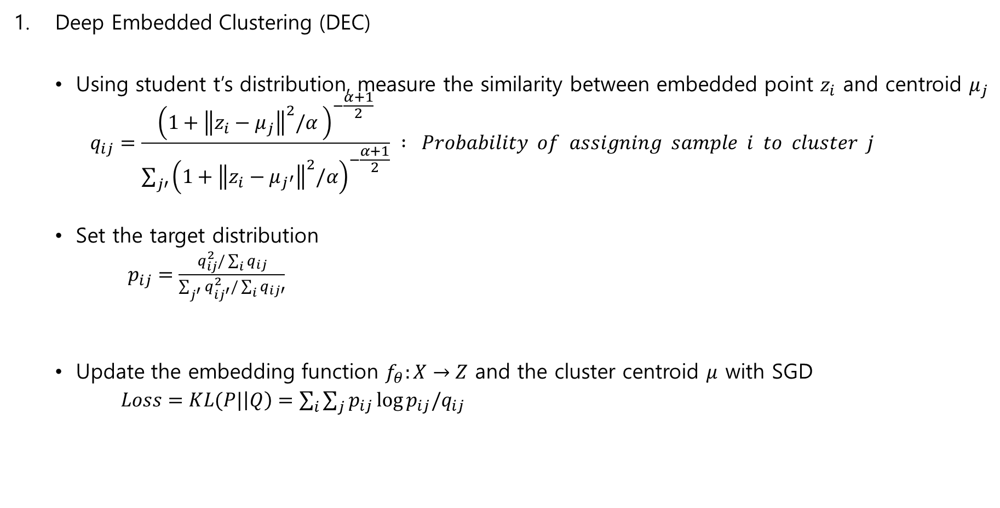
Clustering
Deep Embedded Clustering (DEC)
Using student t’s distribution, measure the similarity between embedded point $z_{i}$ and centroid $μ_{j}$
$$q_{ij}=\frac{{\left(1+{\left\|z_{i}−μ_{j}\right\|}^{2}/α \right)}^{−\frac{α+1}{2}}}{\sum_{j′}{{\left(1+{\left\|z_{i}−μ_{j^{′}}\right\|}^{2}/α\right)}^{−\frac{α+1}{2}}}} : Probability of assigning sample i to cluster j$$
Set the target distribution
$p_{ij}=\frac{q_{ij}^{2}/\sum_{i}{q_{ij}}}{\sum_{j^{′}}{q_{ij^{′}}^{2}/\sum_{i}{q_{ij′}}}}$
Update the embedding function $f_{θ}:X→Z$ and the cluster centroid $μ$ with SGD
$Loss=KL(P|\left|Q\right)=\sum_{i}{\sum_{j}{p_{ij}\log{p_{ij}/q_{ij}}}}$
1. Improve cluster purity
2. Put more emphasis on data points assigned with high confidence
3. Prevent large clusters from distortion by normalization

Slide 21
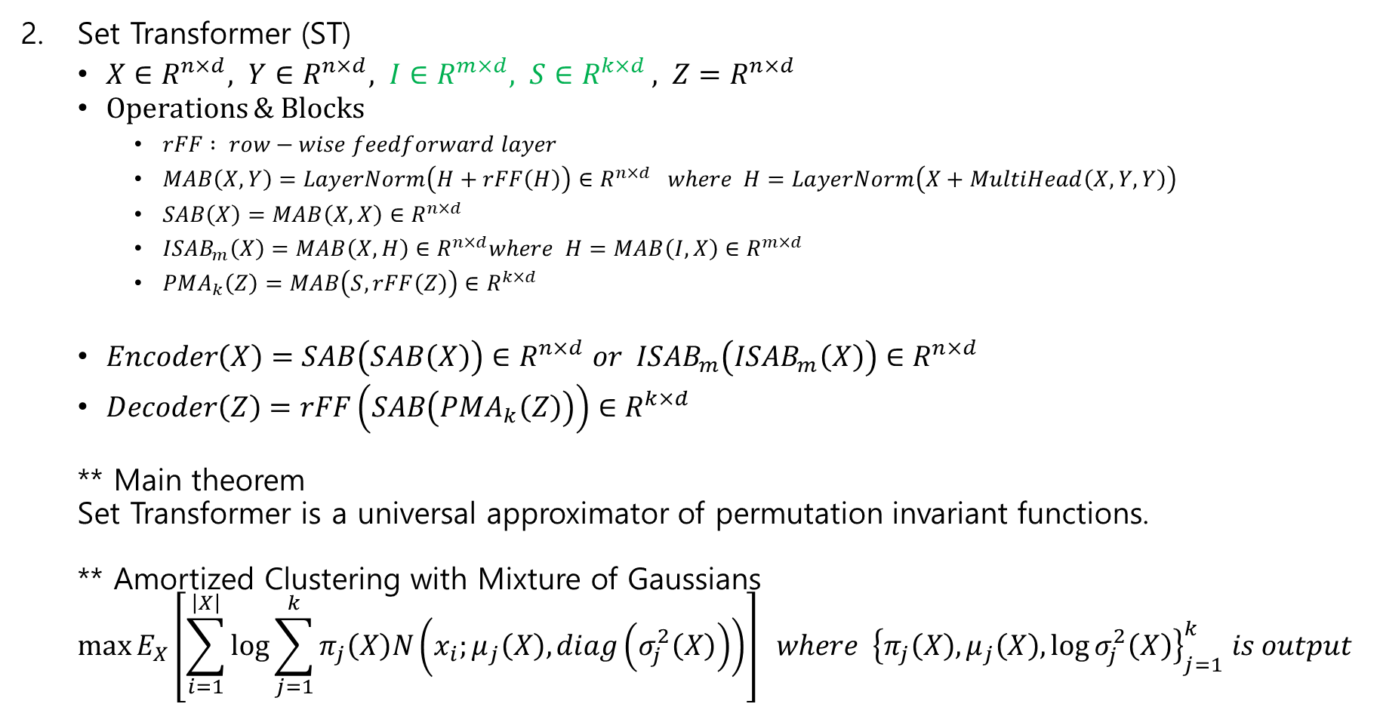
Clustering
Randomly Initialized Learnable Parameters
Set Transformer (ST)
$X∈R^{n×d}, Y∈R^{n×d}, I∈R^{m×d}, S∈R^{k×d }, Z=R^{n×d}$
Operations & Blocks
$rFF : row−wise feedforward layer$
$MAB\left(X,Y\right)=LayerNorm\left(H+rFF\left(H\right)\right)∈R^{n×d} where H=LayerNorm\left(X+MultiHead\left(X,Y,Y\right)\right)$
$SAB\left(X\right)=MAB\left(X,X\right)∈R^{n×d}$
$ISAB_{m}\left(X\right)=MAB\left(X,H\right)∈R^{n×d}where H=MAB\left(I,X\right)∈R^{m×d}$
$PMA_{k}\left(Z\right)=MAB\left(S,rFF\left(Z\right)\right)∈R^{k×d }$
$Encoder\left(X\right)=SAB\left(SAB\left(X\right)\right)∈R^{n×d} or ISAB_{m}\left(ISAB_{m}\left(X\right)\right)∈R^{n×d}$
$Decoder\left(Z\right)=rFF\left(SAB\left(PMA_{k}\left(Z\right)\right)\right)∈R^{k×d}$
** Main theorem
Set Transformer is a universal approximator of permutation invariant functions.
** Amortized Clustering with Mixture of Gaussians
$$\max{E_{X}\left[\sum_{i=1}^{\left|X\right|}{\log{\sum_{j=1}^{k}{π_{j}\left(X\right)N\left(x_{i};μ_{j}\left(X\right),diag\left(σ_{j}^{2}\left(X\right)\right)\right)}}}\right]} where {\left\{π_{j}\left(X\right),μ_{j}\left(X\right),\log{σ_{j}^{2}\left(X\right)}\right\}}_{j=1}^{k} is output$$

Slide 22
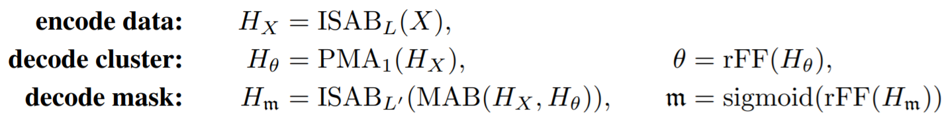
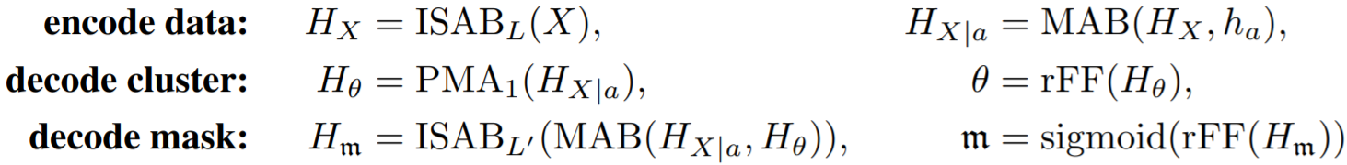
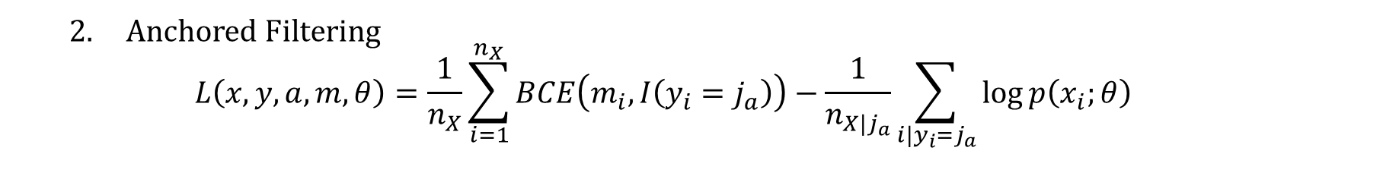
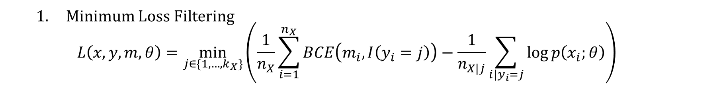
Clustering
Deep Amortized Clustering (DAC)
ST + Filtering
Minimum Loss Filtering
$$L\left(x,y,m,θ\right)=\min_{j∈\{1,…,k_{X}\}}\left(\frac{1}{n_{X}}\sum_{i=1}^{n_{X}}{BCE\left(m_{i}, I\left(y_{i}=j\right)\right)}−\frac{1}{n_{X|j}}\sum_{i|y_{i}=j}{\log{p\left(x_{i};θ\right)}}\right)$$
Anchored Filtering
$$L\left(x,y,a,m,θ\right)=\frac{1}{n_{X}}\sum_{i=1}^{n_{X}}{BCE\left(m_{i}, I\left(y_{i}=j_{a}\right)\right)}−\frac{1}{n_{X|j_{a}}}\sum_{i|y_{i}=j_{a}}{\log{p\left(x_{i};θ\right)}}$$

Slide 23
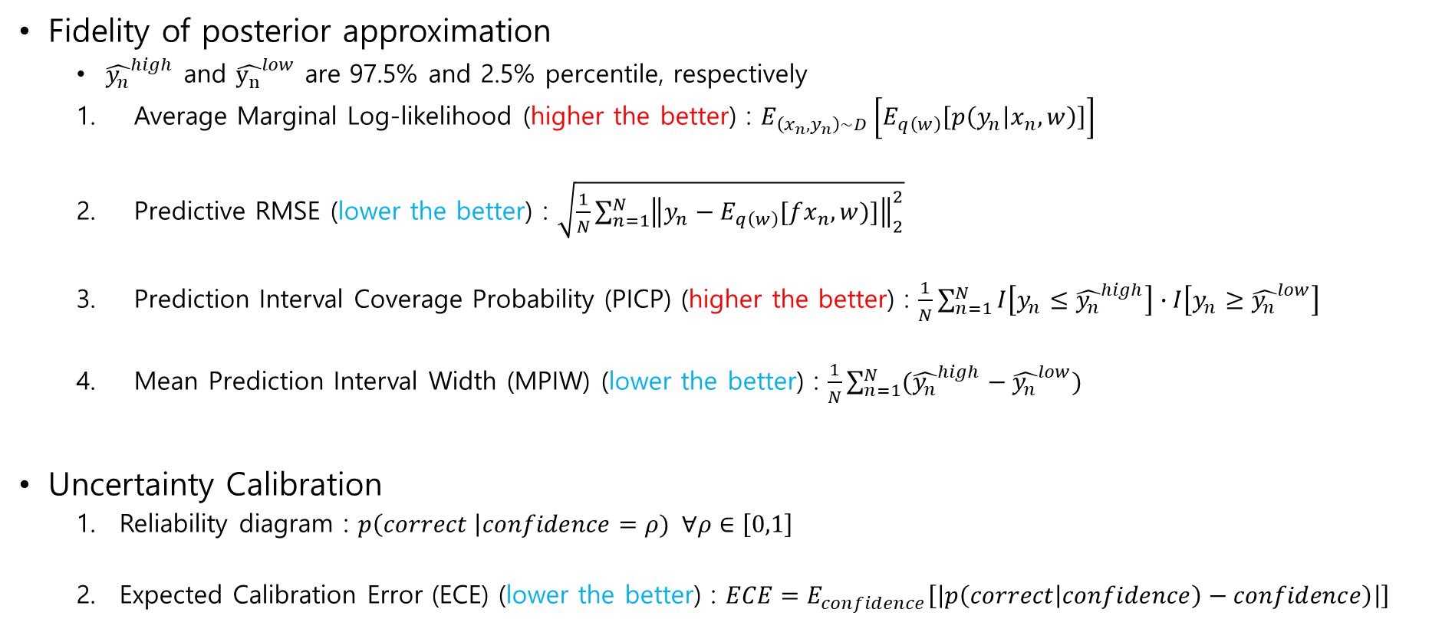
Evaluation Metrics in BNN
Fidelity of posterior approximation
${\hat{y_{n}}}^{high}$ and ${\hat{y_{n}}}^{low}$ are 97.5% and 2.5% percentile, respectively
Average Marginal Log-likelihood (higher the better) : $E_{\left(x_{n},y_{n}\right)\sim D}\left[E_{q\left(w\right)}\left[p\left(y_{n} | x_{n},w\right)\right]\right]$
Predictive RMSE (lower the better) : $\sqrt{\frac{1}{N}\sum_{n=1}^{N}{{\left\|y_{n}−E_{q\left(w\right)}[fx_{n},w)]\right\|}_{2}^{2}}}$
Prediction Interval Coverage Probability (PICP) (higher the better) : $\frac{1}{N}\sum_{n=1}^{N}{I\left[y_{n}≤{\hat{y_{n}}}^{high}\right]∙I\left[y_{n}≥{\hat{y_{n}}}^{low}\right]}$
Mean Prediction Interval Width (MPIW) (lower the better) : $\frac{1}{N}\sum_{n=1}^{N}{({\hat{y_{n}}}^{high}−{\hat{y_{n}}}^{low})}$
Uncertainty Calibration
Reliability diagram : $p\left(correct \right|confidence=ρ) ∀ρ∈\left[0,1\right]$
Expected Calibration Error (ECE) (lower the better) : $ECE=E_{confidence}\left[\left|p\left(correct\left|confidence\right)−confidence\right)\right|\right]$

